Slide 1
Travel Sathi - A Platform to Find Companions for Shared Rides
SDE MINI PROJECT-GROUP NO 35
Akaash Chatterjee (m24cse002)
aman Saini (m24cse003)
bera SWAMINATH ANSUMAN SABITA (m24cse007)

Slide 2
ObJECTIVE Of Project
The project aims to create a secure online platform that facilitates shared transportation for college students, starting with rides between key locations like IIT Jodhpur and Jodhpur Junction. Users can post when they are looking for companions for a ride, and others can search for available rides to join. To ensure privacy and safety, the platform offers gender-specific pairing options—female users can choose to travel with female partners only, and the same applies to male users, with an additional co-ed option available. No personal details are shared among users. The platform will also include a database of trusted autorickshaw drivers operating within the IITJ campus. The final aim is to apply containerization using Docker and virtualization based on a Fedora VM using VirtualBox and compare the performance metrics of our website on both.

Slide 3
Overview Of Project
Create the website
Containerize using Docker
Virtualize using Fedora and VirtualBox
Compare Metrics using Apache Benchmarks

Slide 4
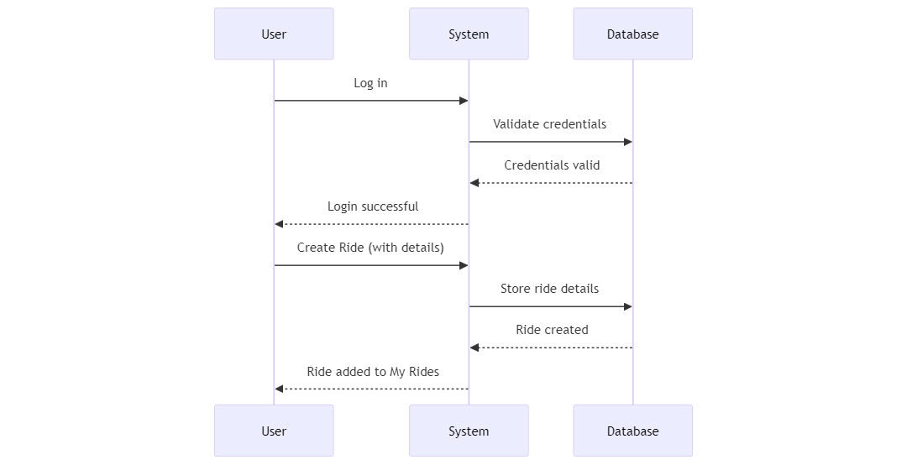
Sequence Diagrams

Slide 5
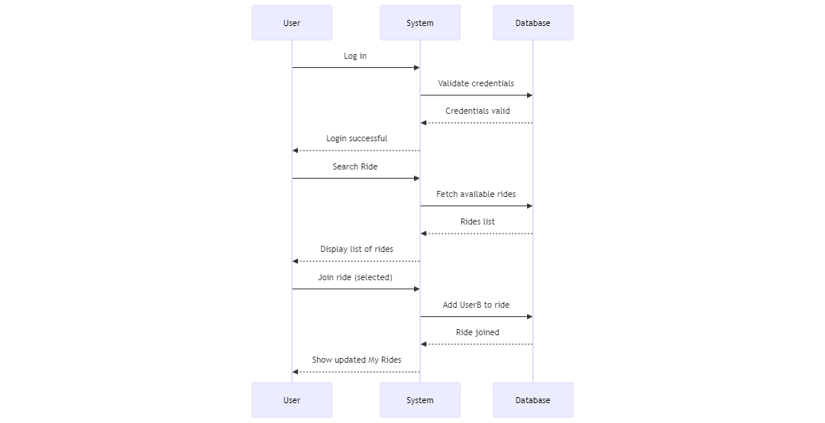
Sequence Diagrams

Slide 6
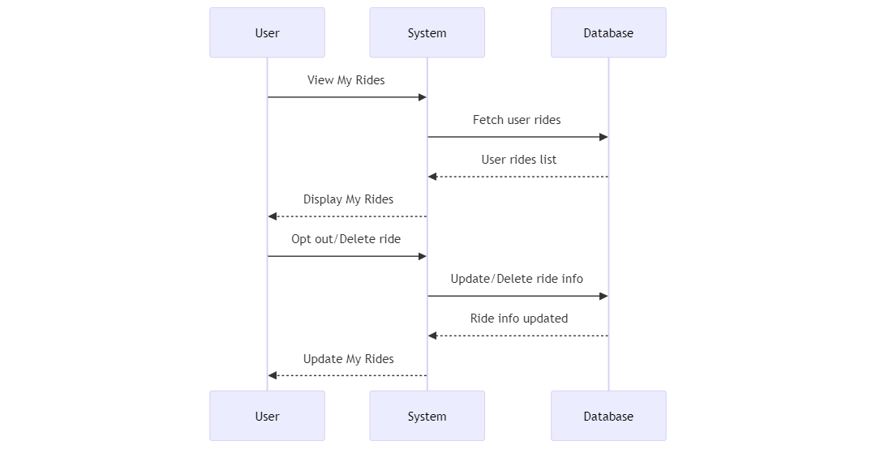
Sequence Diagrams

Slide 7
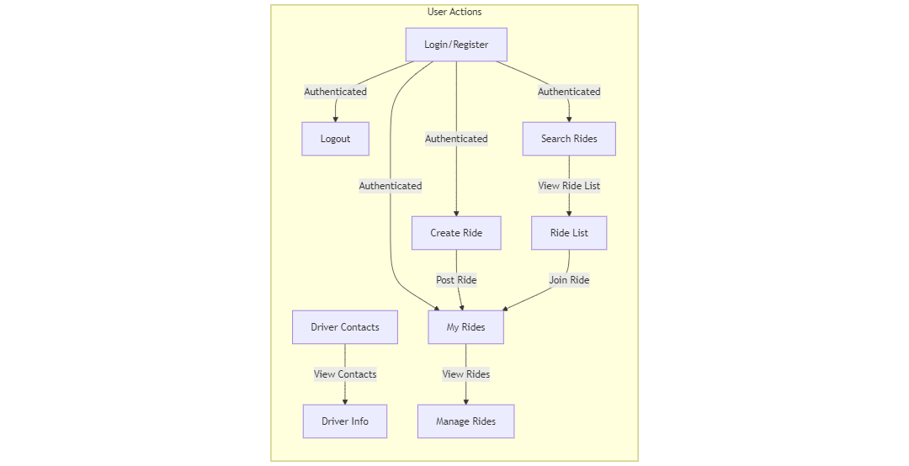
USER FLOW DIAGRAM

Slide 8
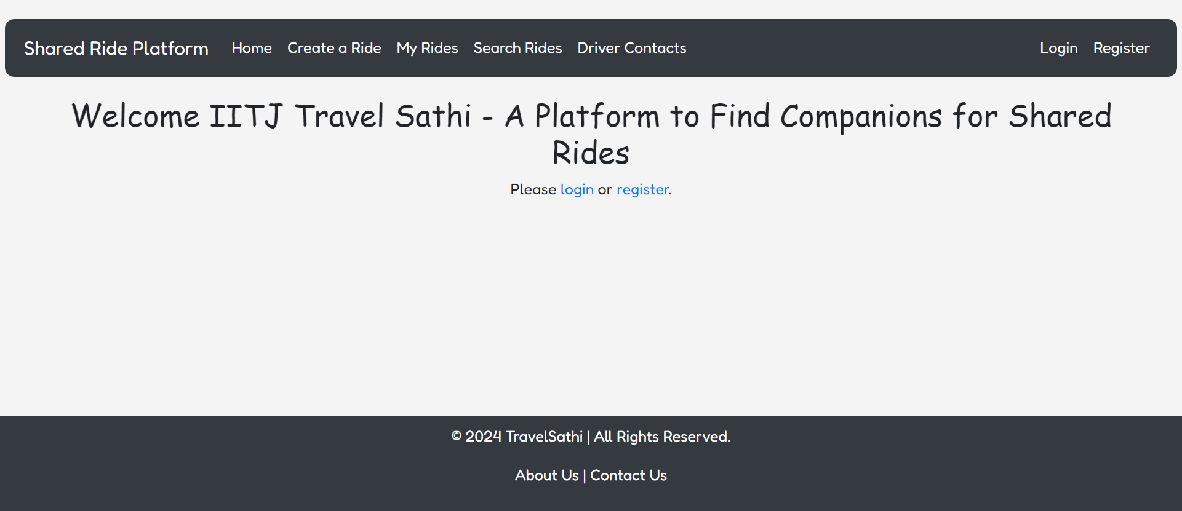
WEBSITE VIEW

Slide 9
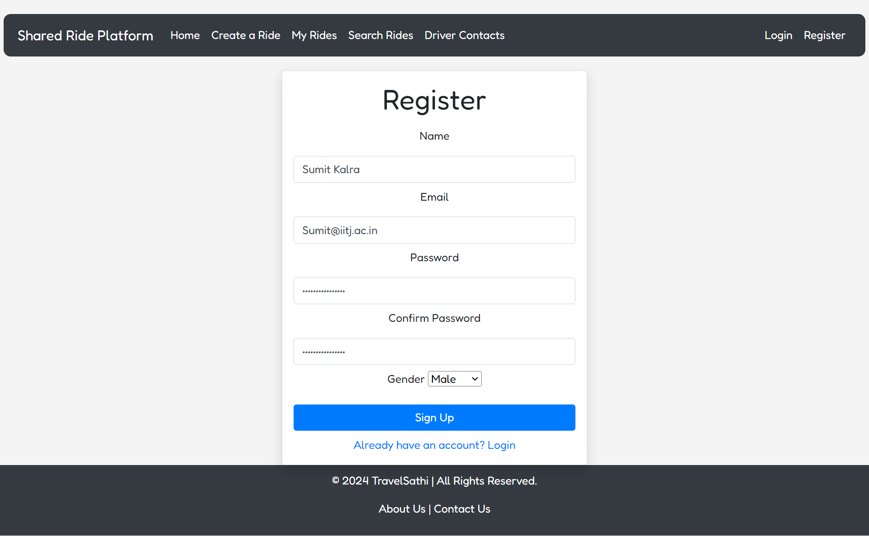
WEBSITE VIEW

Slide 10
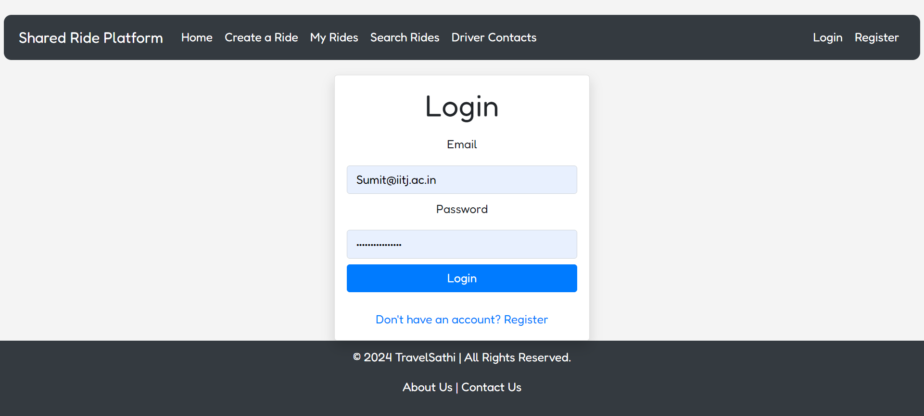
WEBSITE VIEW

Slide 11
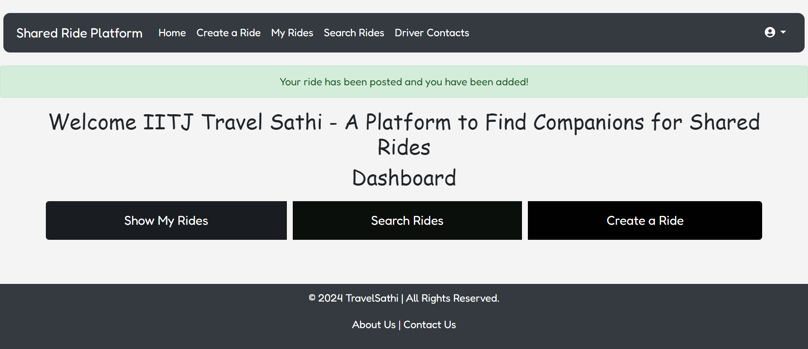
WEBSITE VIEW

Slide 12
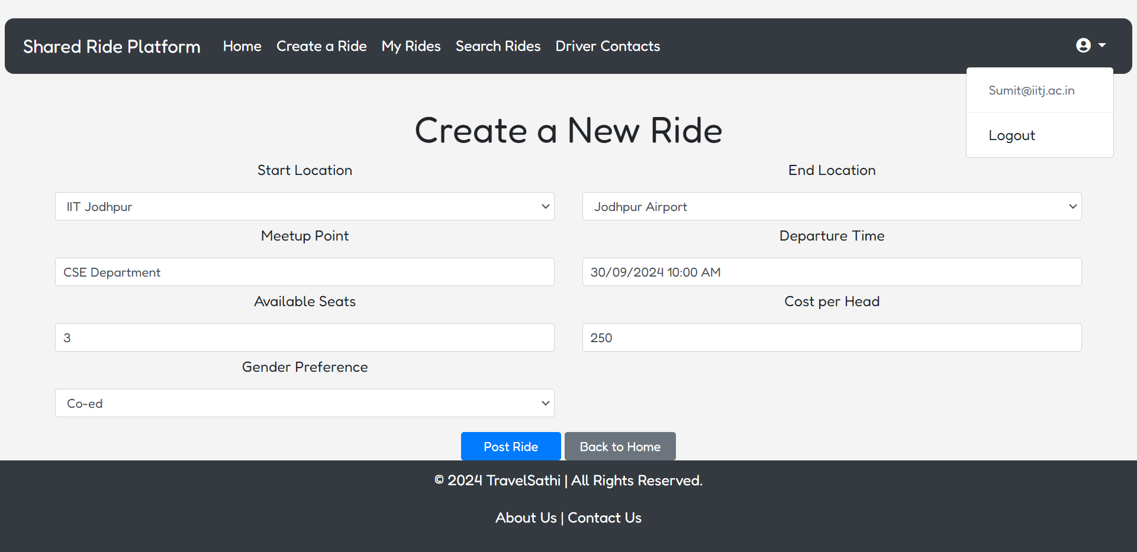
WEBSITE VIEW

Slide 13
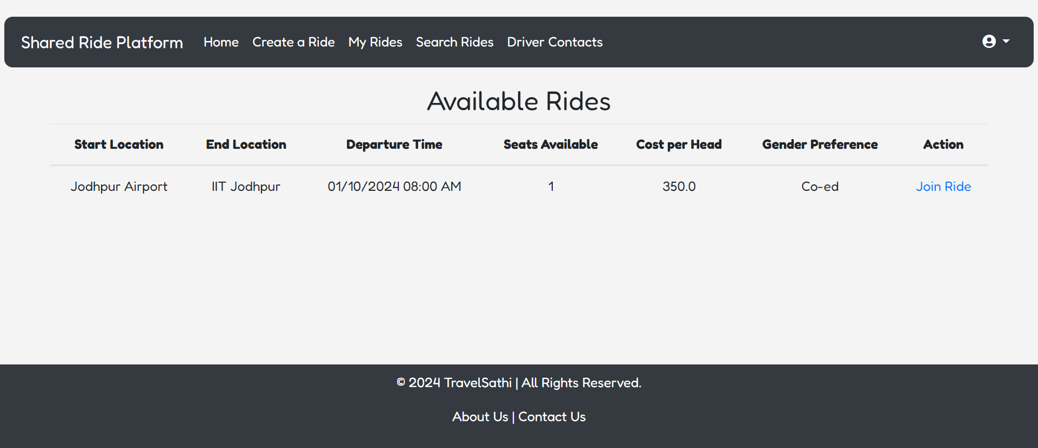
WEBSITE VIEW

Slide 14
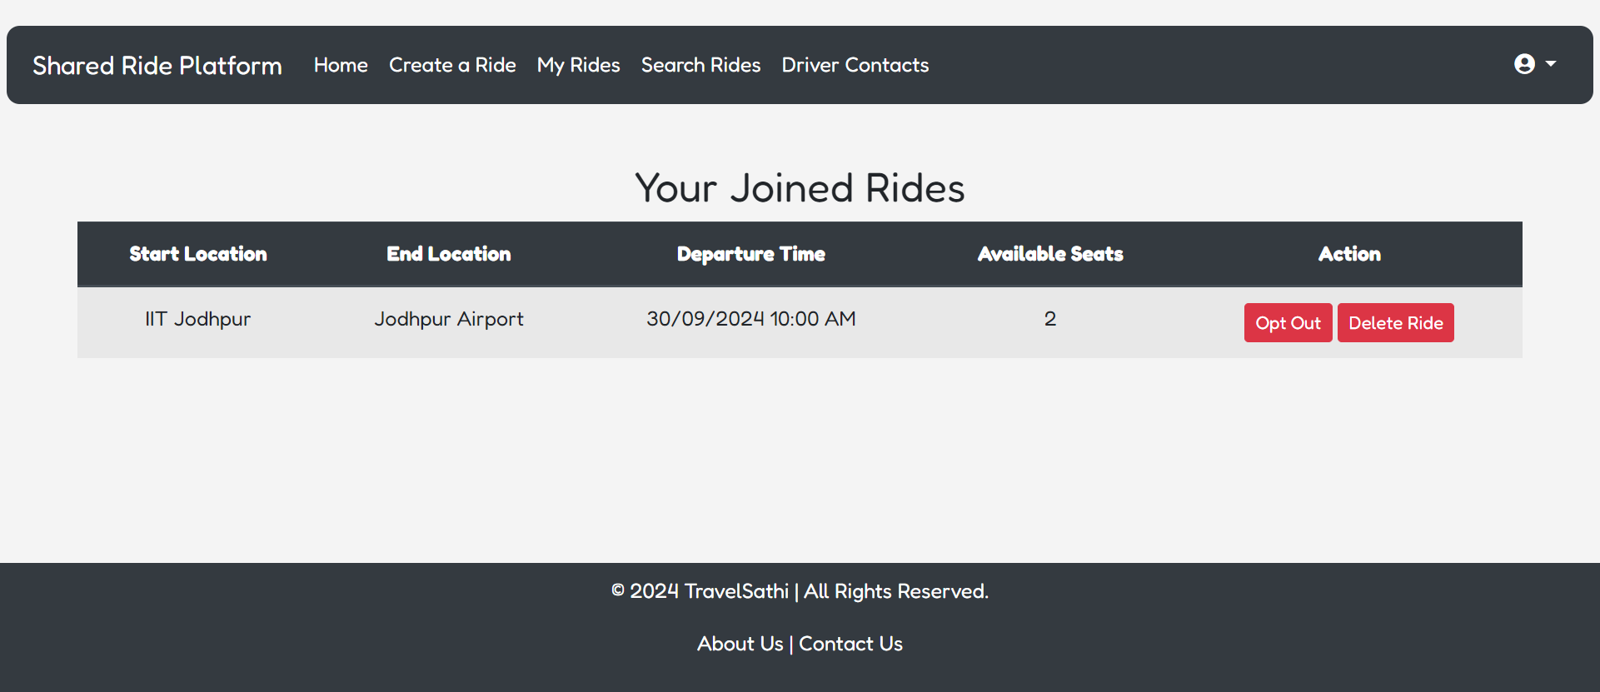
WEBSITE VIEW

Slide 15
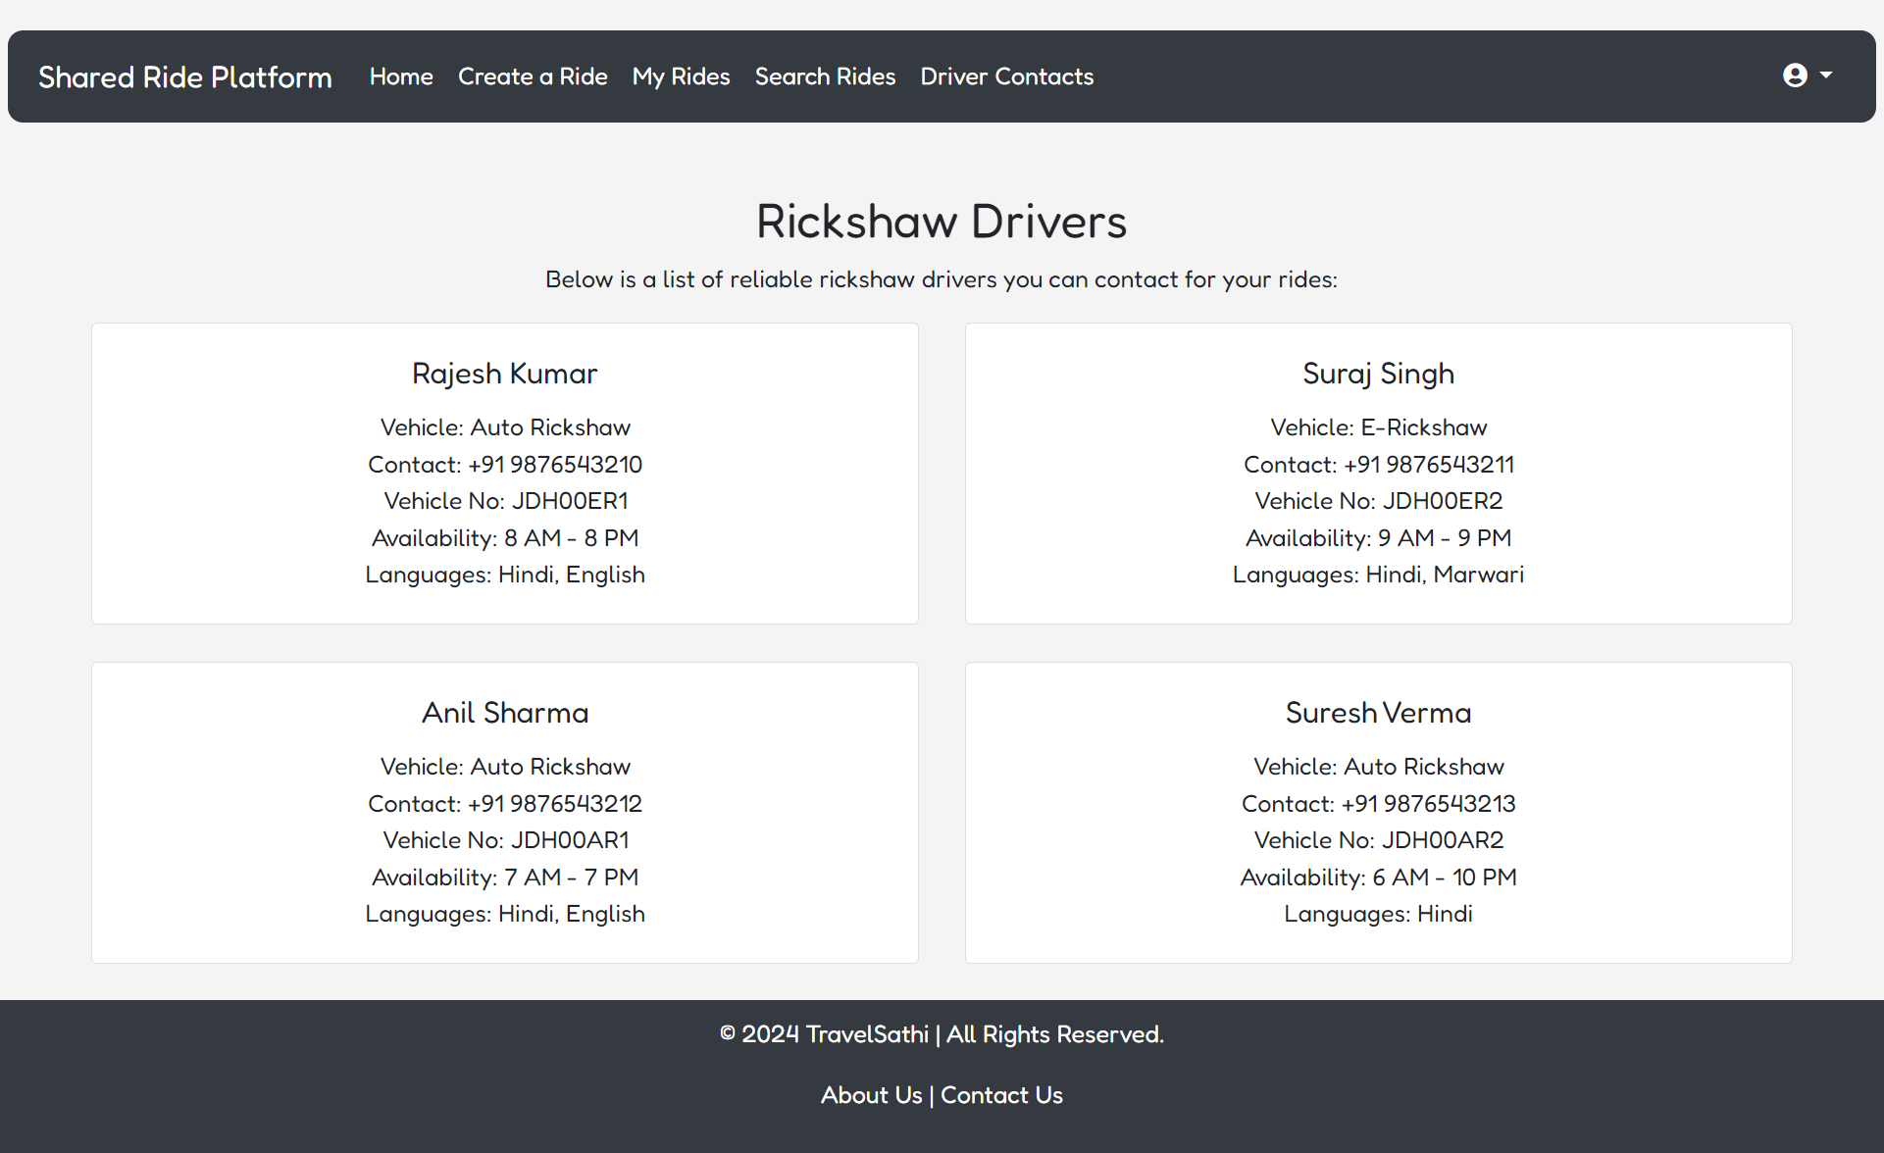
WEBSITE VIEW

Slide 16
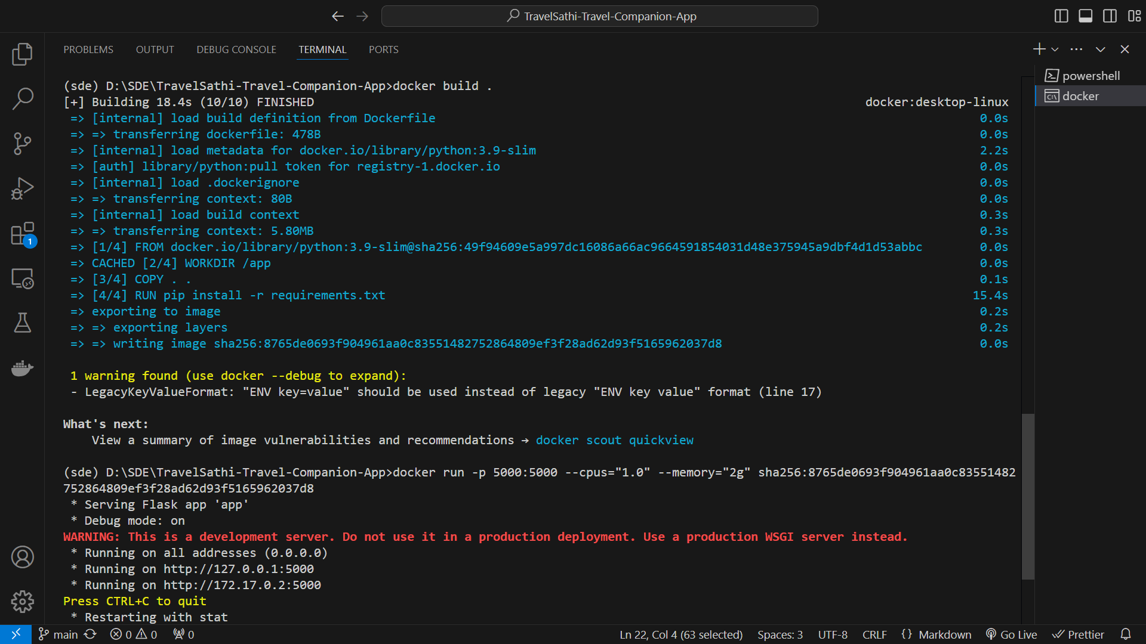
CONTAINERIZATION

Slide 17
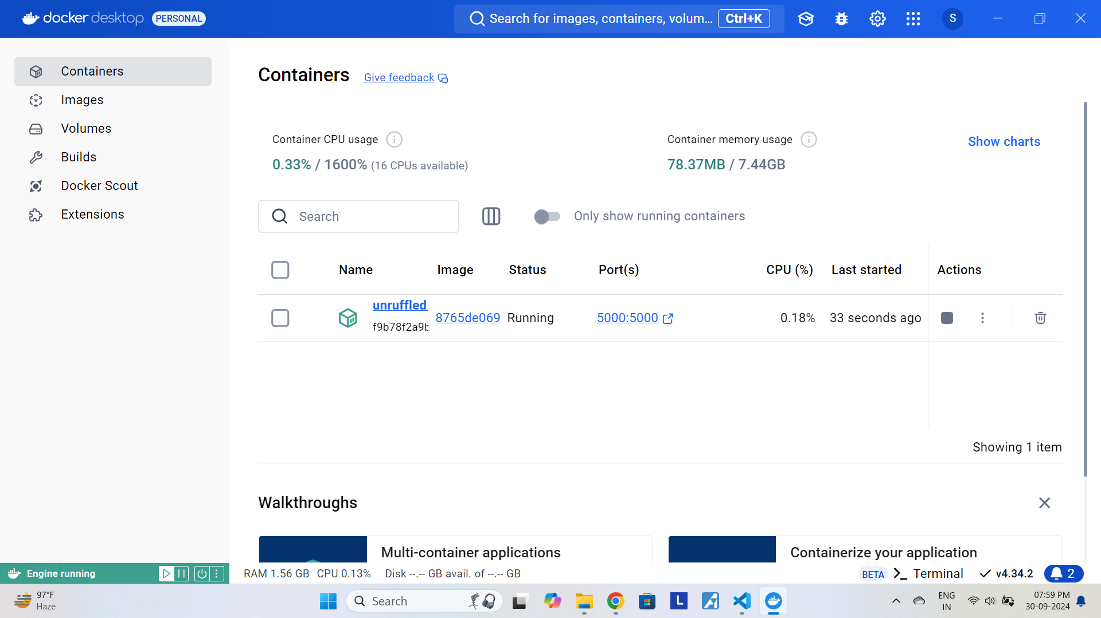
CONTAINERIZATION

Slide 18
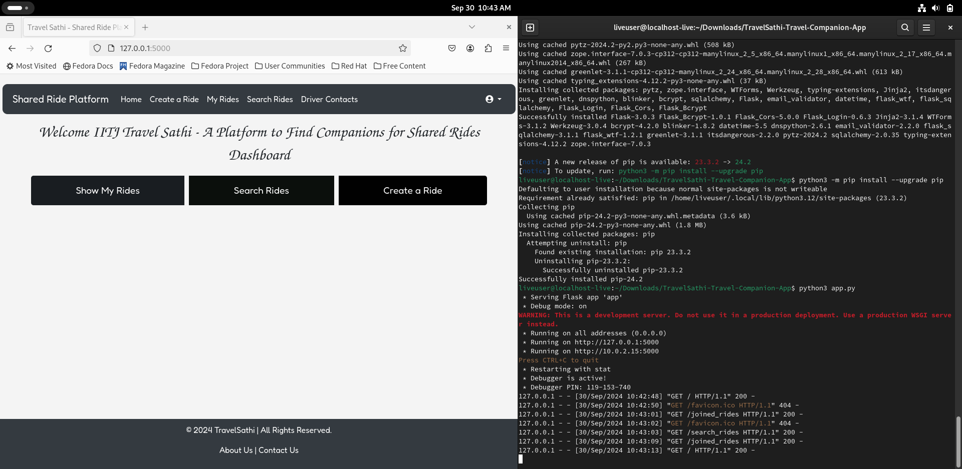
virtualization

Slide 19
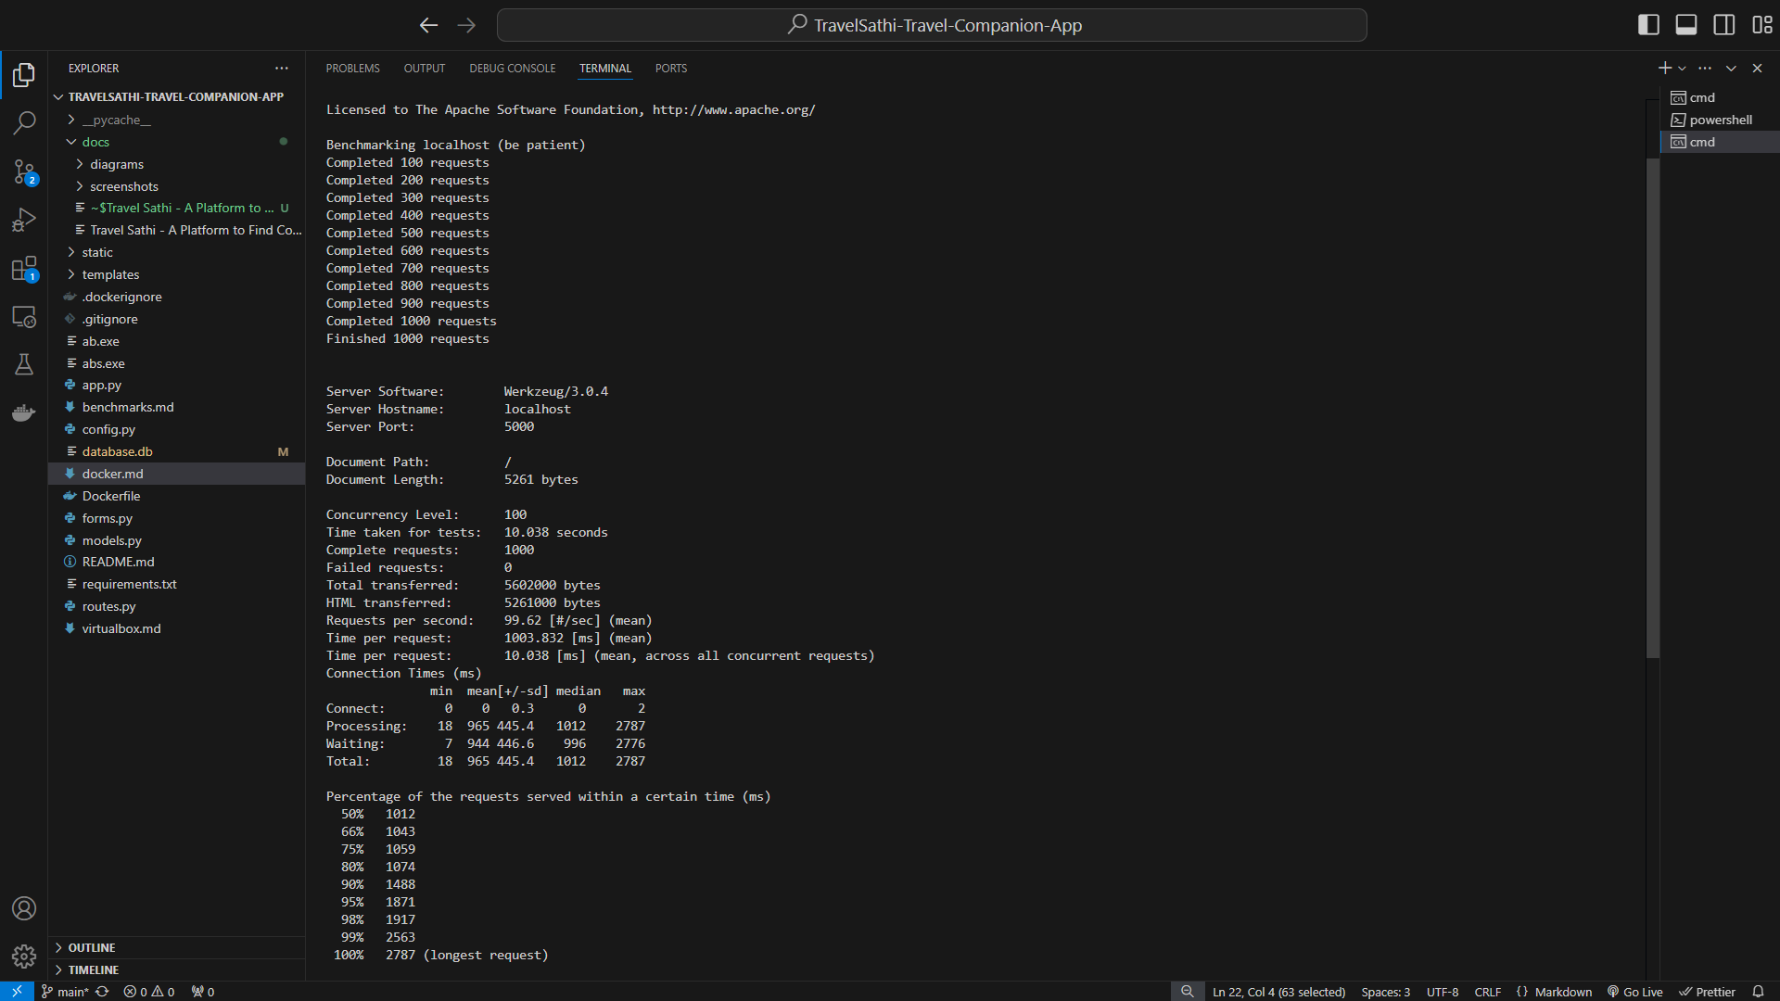
rEsULTS

Slide 20
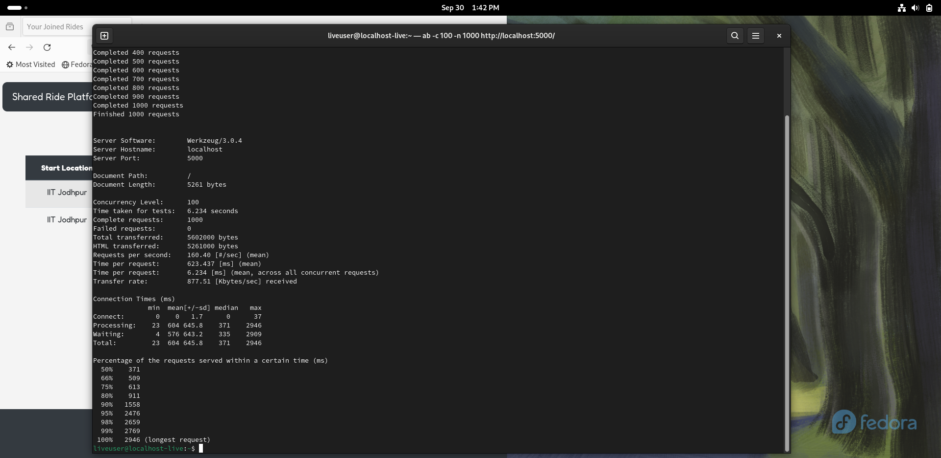
rEsULTS

Slide 21
THANK YOU

